Slide 1
Anusha's Supermarket A Project by Faraz Ghani 21sw081

Slide 2
What this program does?
This program can be used in retail system for shopping experience of the customers. It can easily be modified by modifying the price and/or the item itself by editing the .txt files provided along with the source code. When the shopping experience is completed a receipt is generated in txt file that can be printed into a hard copy to provide the customer a proof of their purchase.

Slide 3
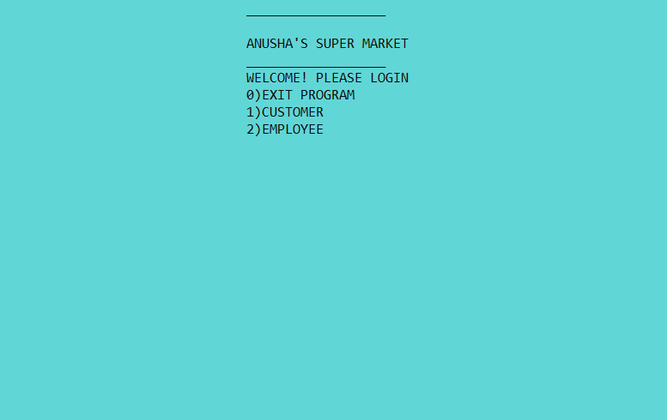
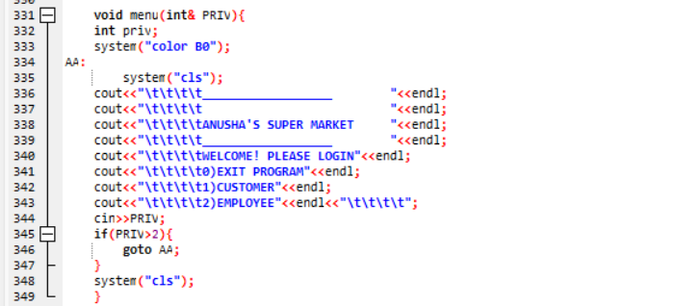
UI
The program starts of at the welcome page where it asks the user wether they are a customer or an
Employee.This is done in order to decide wether to apply the special empolyee discount to the total or not.

Slide 4
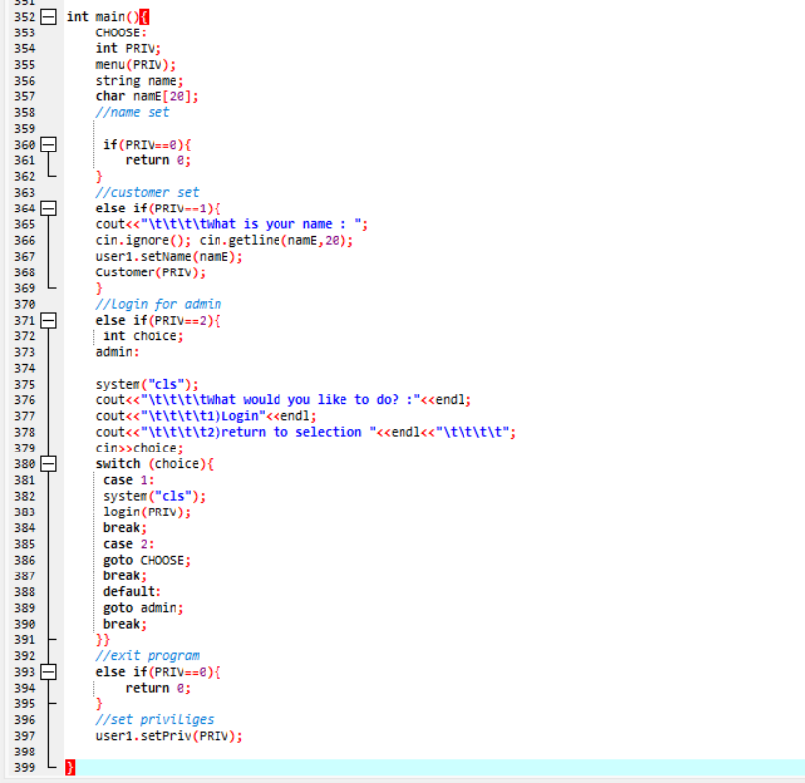
UI
The main function basically gets the customer name and calls the functions

Slide 5
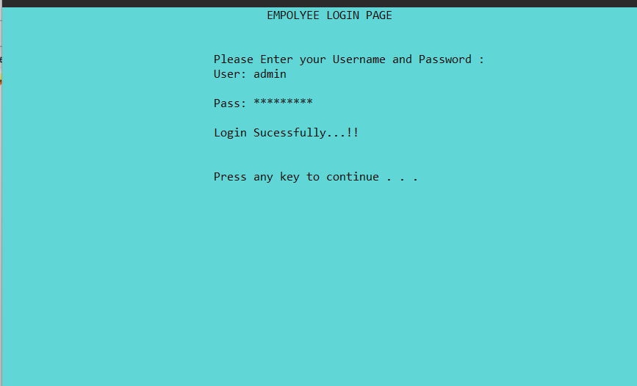
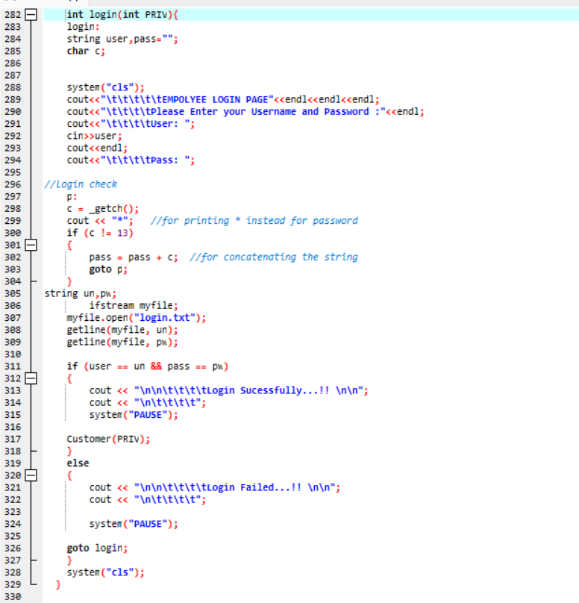
Login system
If the user chooses the employee option then they will be directed to a login system where they must enter the employee username and password in order to utilize the discount.

Slide 6
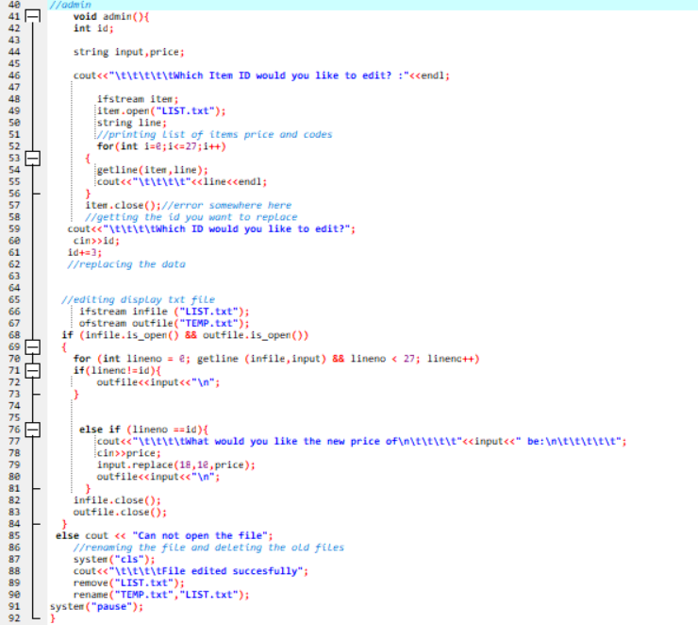
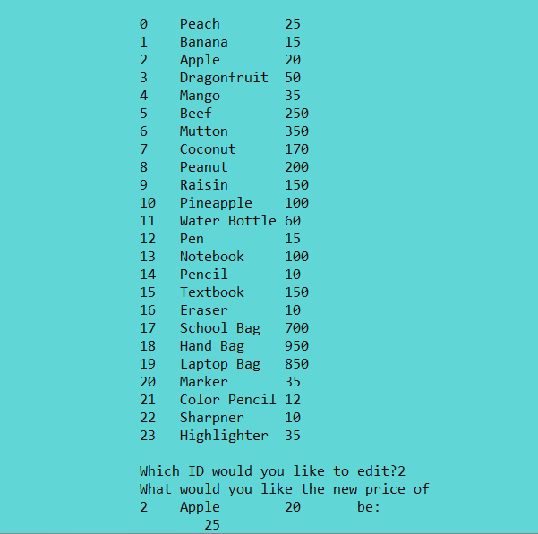
Price management.
After the login the user will have an addition option to edit the prices of the items which will ultimately edit the txt file.

Slide 7
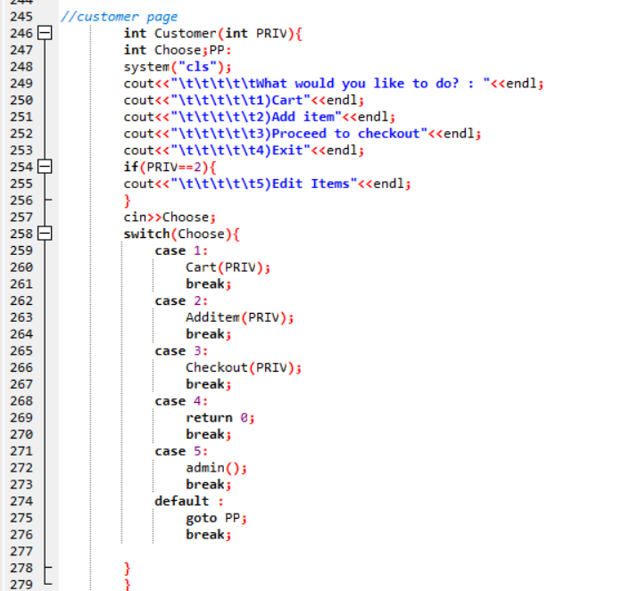
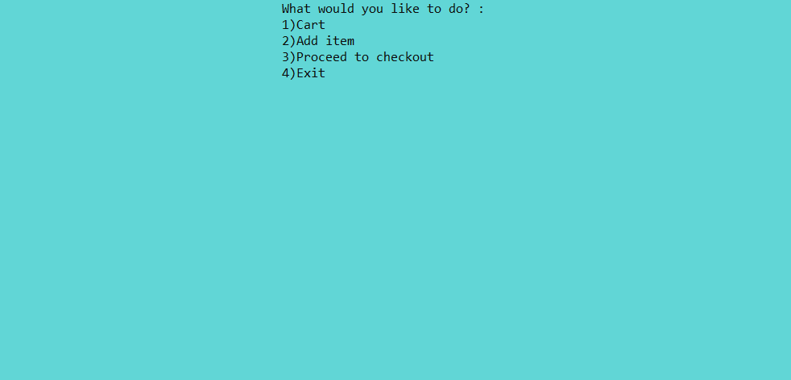
Main menu
Here the user can add to their cart, check their cart, continue to checkout or exit the program.

Slide 8
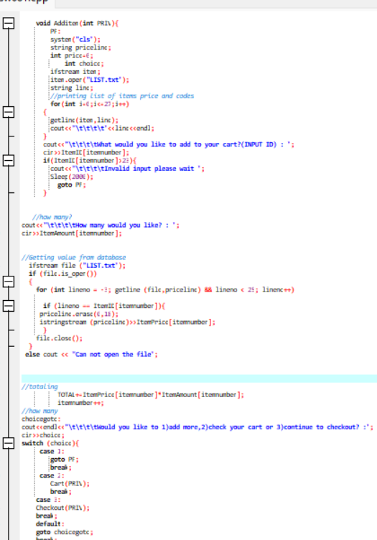
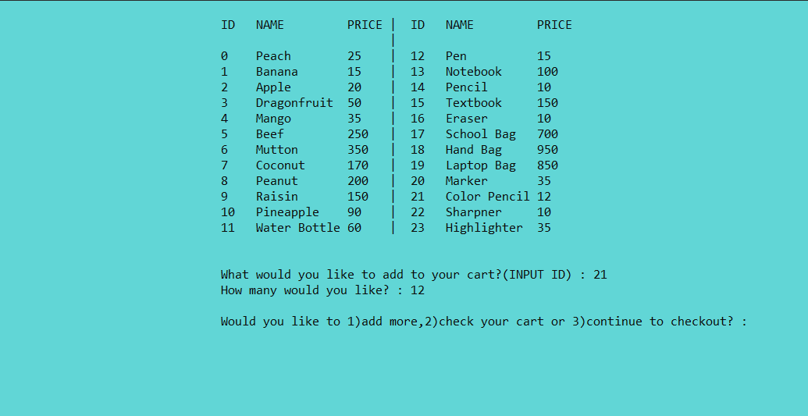
Stock
When the users selects the add item option then they are provided with a list of items along with their price. This list can easily be modified by modifying the .txt files as explained earlier.

Slide 9
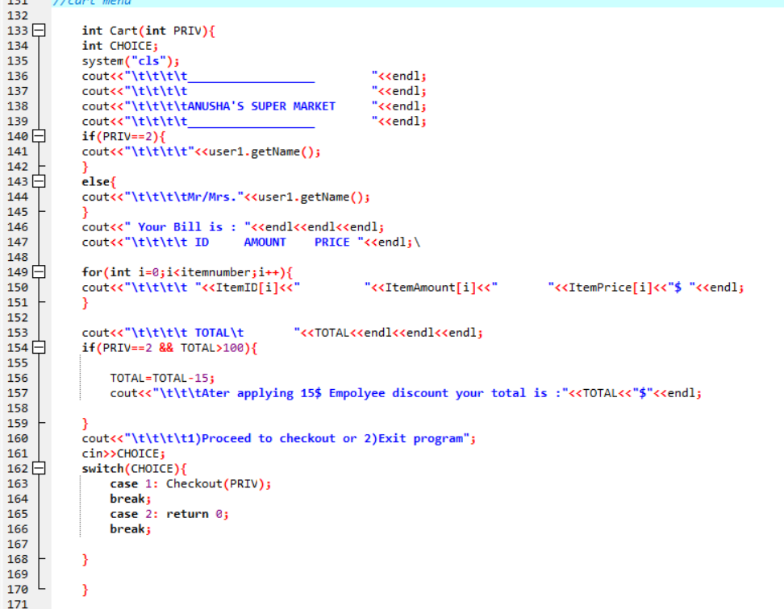
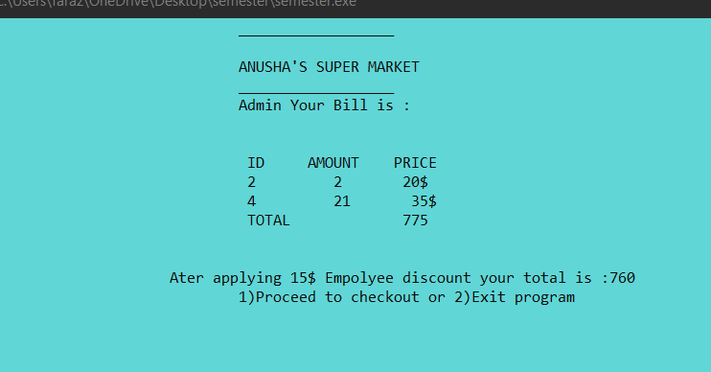
CART
The user interface of the cart is simple and displays a replica of what the receipt will look like.

Slide 10
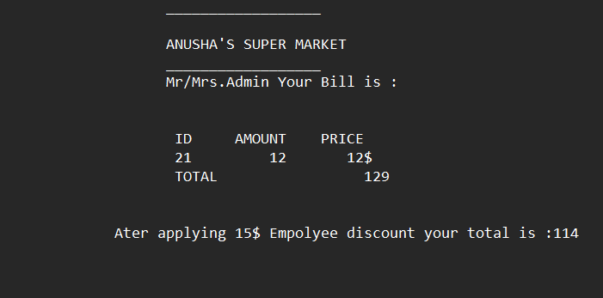
RECEIPT
This is a preview of a sample receipt.

Slide 11
THANKS!

